Slide 1
CRM System
John Abbott IPD8 “DotNet” course group project
Nazar Holyanskyy & Valeriy Hohin

Slide 2
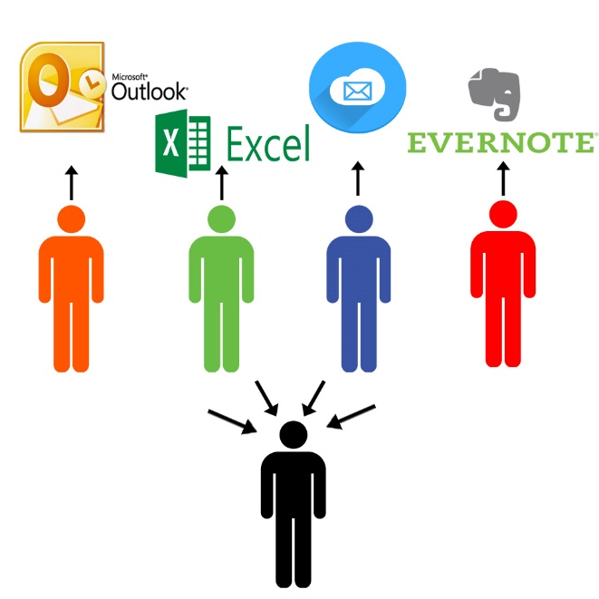

CRM System
the purpose of the implementation is data centralization
To save information
To analyze data
To avoid duplication of data

Slide 3
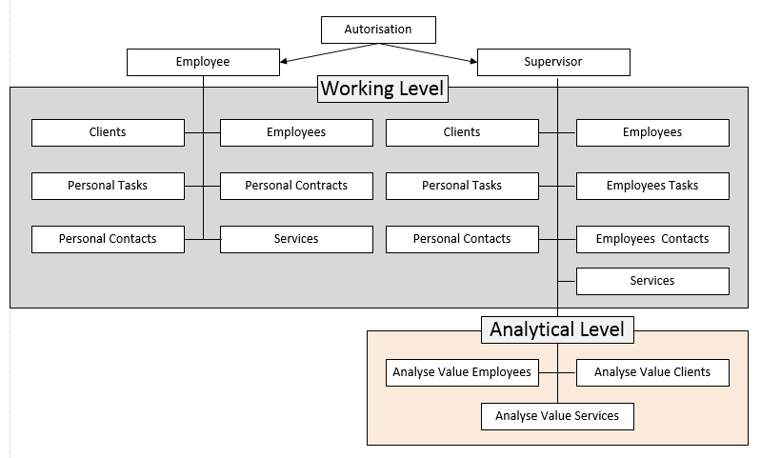
BACKGROUND
Application schema is a two-levels user application which allows to manage same data with different types of access

Slide 4
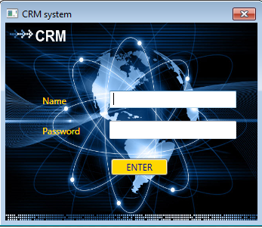
SOLUTION OVERVIEW
Multi-user Login Main Window
Password and Name checks, if both match – log in
Different access rights (Add/Modify buttons, views) depending on seniority
Focus, Tab

Slide 5
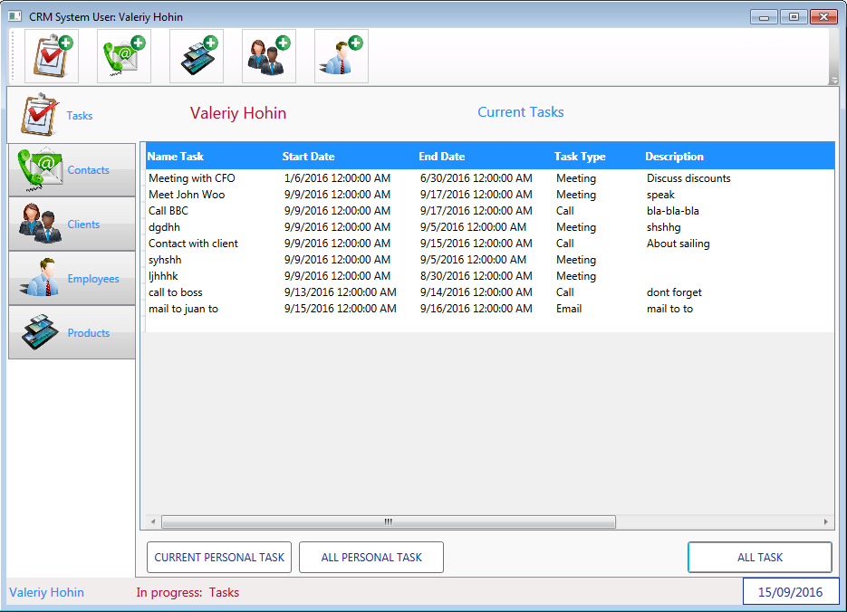
SOLUTION OVERVIEW
Task Manager Form
Individual and Manager
Tasks View:
Current personal task (for Employee)
All personal task (for Employee)
All tasks (available to Manager only)
Double-click on task and
Task Info window show-ups

Slide 6
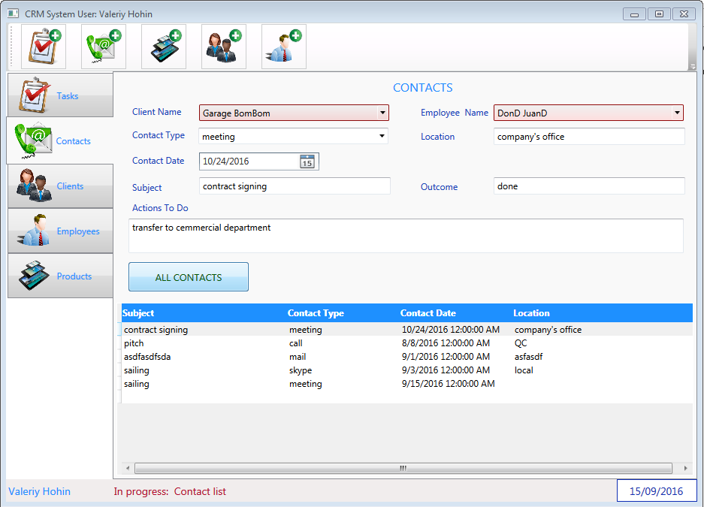
SOLUTION OVERVIEW
Contact Info (Opportunity list)
Contacts selection
Filtering info by Client
Filtering info by Employee
All contacts
Data Grid view, Tab button
move

Slide 7
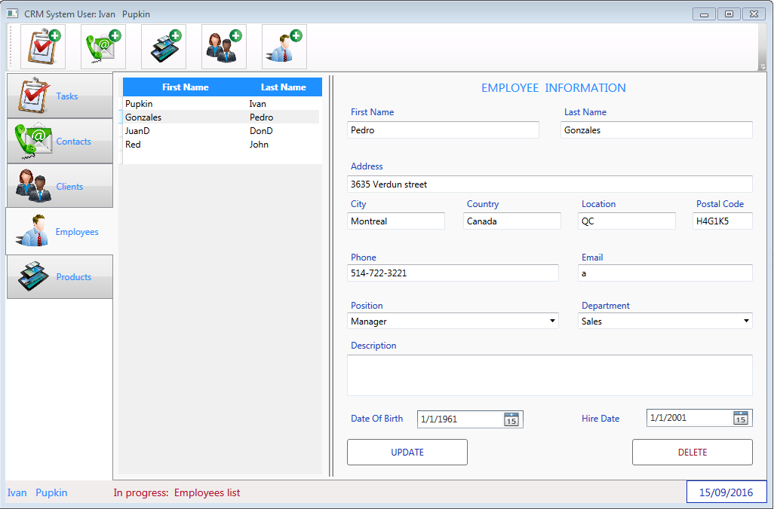
SOLUTION OVERVIEW
Employee Info
Combo Boxes with uploaded data from Database
Read-only fields for Employee
Update and Delete (Manager’s tool only)

Slide 8
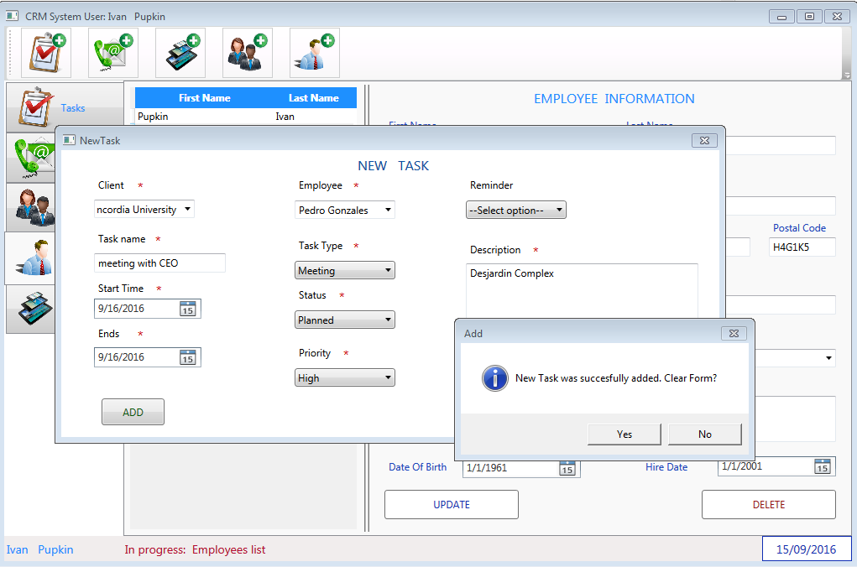
SOLUTION OVERVIEW
Add Items (Task, Contact, Client, etc.) Form
Addition with Validation
Storing input data in Database

Slide 9
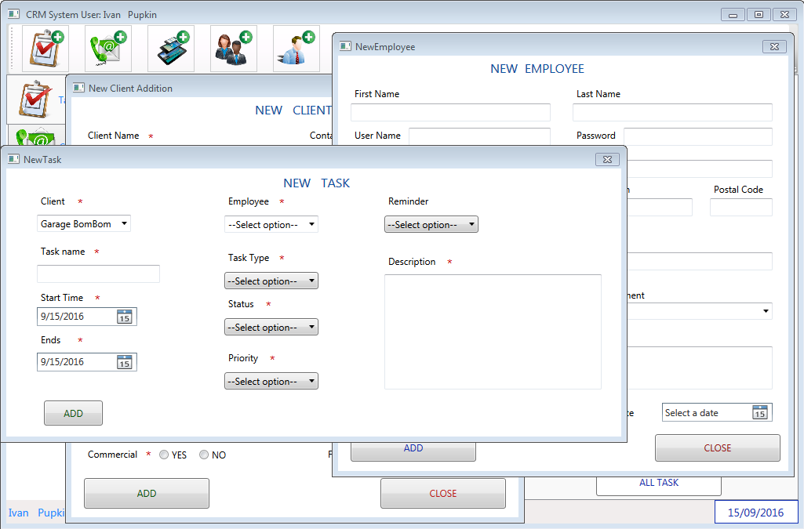
CHALLENGES AND SOLUTIONS
Challenge – Multiple Windows
Splash Window
Multiple Independent Windows with ability to switch between them

Slide 10
CHALLENGES AND SOLUTIONS
Challenge – Data Binding
Proper Database Structure and Tables link (PK and FK)
Method call and SQL query
Fetching/modifying data from database and reflecting them in WPF in correct fields

Slide 11
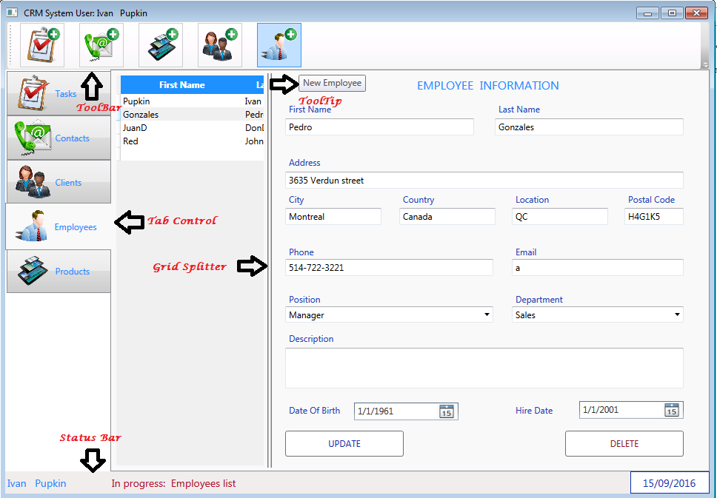
CHALLENGES AND SOLUTIONS
Challenge – Different Controls
Data Grid view
Toolbar
Tab Control
Status Bar
Grid Splitter
Tooltips

Slide 12
WHAT WE LEARNED
GitHub use – Industry requirement
Scrum/Agile – Management tool
Resolving merge conflicts in Git
WPF Resources – (images, styles, triggers for buttons, datagrid list)
Data Binding
Unit Testing
Intro to Libraries

Slide 13

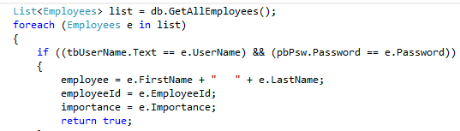
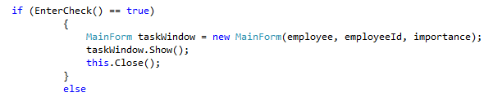

WHAT WE LEARNED
Code-Behind to Enter CRM System by Password Check
…
…
…

Slide 14
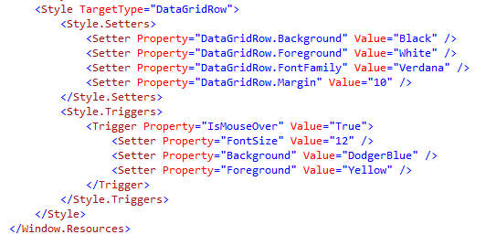
WHAT WE LEARNED
XAML code to WPF Resources (image, style, trigger)
…

Slide 15
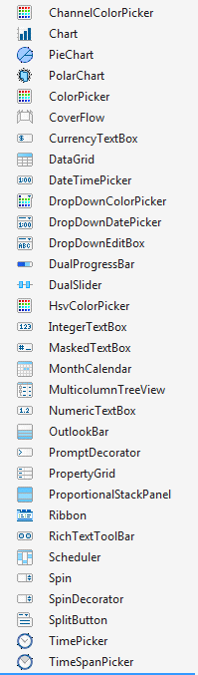
WHAT WE LEARNED
Touched MINDSCAPE – free WPF Controls Library
Tried (Schedular, MonthCalendar), but did not implement in the project because it’s a trial version

Slide 16
CRM System
FUTURE WORK
Add Analysis Section
Develop advanced user-friendly GUI
Develop graphical Scheduler

Slide 17
CRM System
SUMMARY
With what RESULT:
Practical knowledge
Valuable experience
Project done
What was DONE:
CRM application plus test cases
Team project with active interaction using industry tools
Lots of Googling
WHAT TO DO NEXT???
KEEP LEARNING AND DIGGING

Slide 18


